Slide 1

Geometry
Unit 4, Lesson 3 Sequences of Transformations Volume 1, pg. 190

Slide 2


Benchmarks
MA.912.GR.2.2
Identify transformations that do or do not preserve distance.
MA.912.GR.2.3
Specify a sequence of transformations that will map a given figure onto itself, or onto another congruent or similar figure.
volume 1, pg. 190

Slide 3
Integrated Mathematical Thinking and Reasoning Standards
MA.K12.MTR.2.1
Demonstrate understanding by representing problems in multiple ways.
MA.K12.MTR.4.1
Engage in discussions that reflect on the mathematical thinking of self and others.
MA.K12.MTR.5.1
Use patterns and structure to help understand and connect mathematical concepts.
volume 1, pg. 190

Slide 4

Learning Targets
I can identify transformations that preserve distance.
I can specify a sequence of transformations that will map a given figure onto another congruent figure.
volume 1, pg. 190

Slide 5

Warm-Up
volume 1, pg. 190

Slide 6
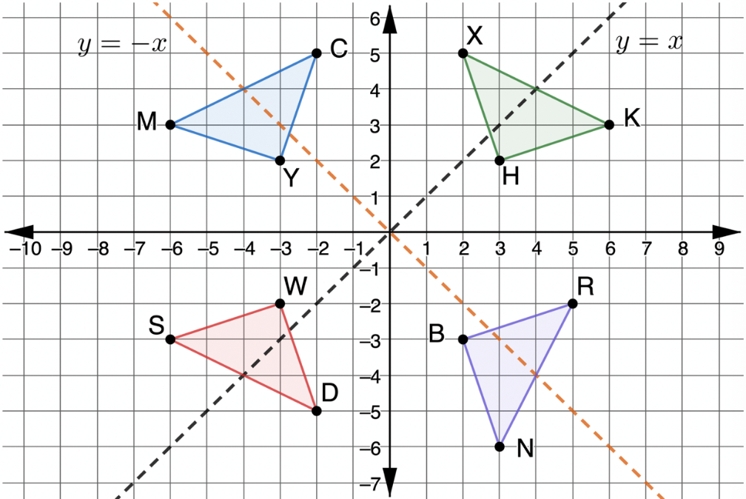
4.3.1 Warm-Up: Bell Work
Triangles $MCY$, $KXH , NRB,$and $SWD$ are shown on the coordinate grid.
volume 1, pg. 190

Slide 7
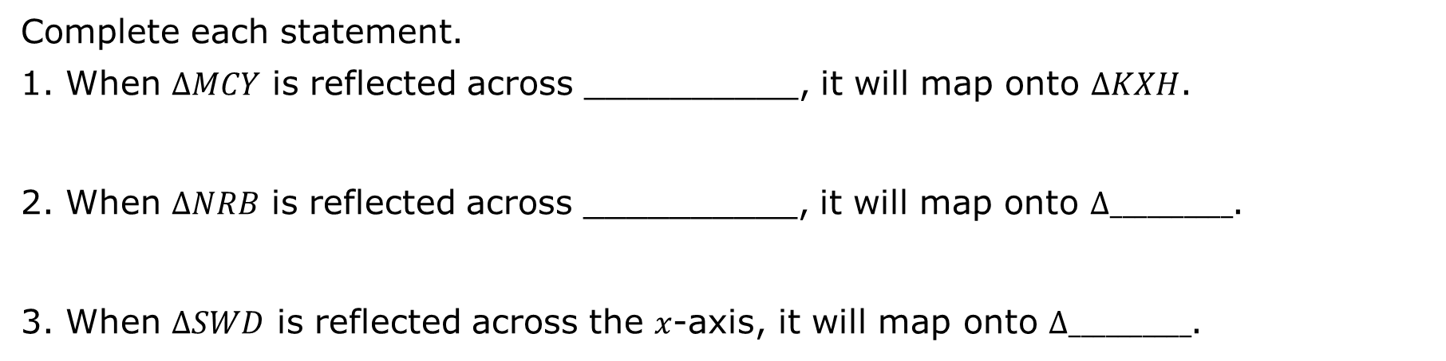
Complete each statement.
When $∆MCY$ is reflected across __________, it will map onto $∆KXH$.
When $∆NRB$ is reflected across __________, it will map onto $∆__________$.
When $∆SWD$ is reflected across the $x$-axis, it will map onto $∆__________$.
volume 1, pg. 190

Slide 8

Guided Instruction
volume 1, pg. 191

Slide 9
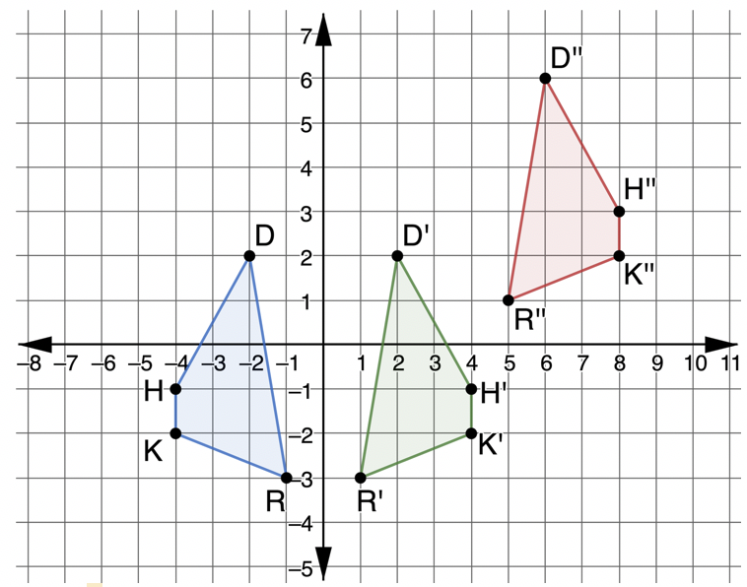
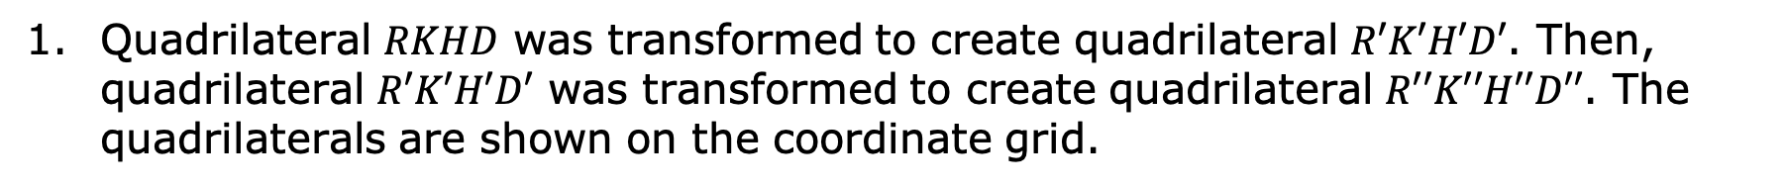
4.3.2 Guided Instruction: Sequence of Transformations
Quadrilateral $RKHD$ was transformed to create quadrilateral $R′K′H′D′$. Then, quadrilateral $R′K′H′D′$ was transformed to create quadrilateral $R′′K′′H′′D′′$. The quadrilaterals are shown on the coordinate grid.
volume 1, pg. 191

Slide 10
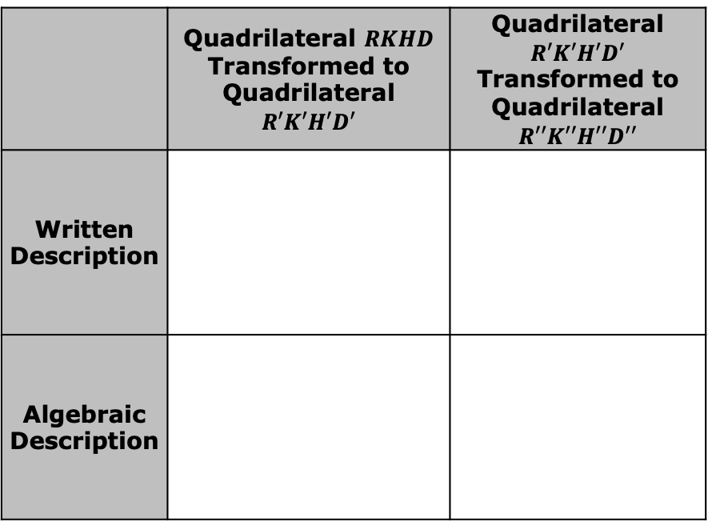
On the graph, show the mappings of the vertices of the first transformation.
On the graph, show the mappings of the vertices of the second transformation.
Complete the table.
 | Quadrilateral $RKHD$ Transformed to Quadrilateral $R′K′H′D′$ | Quadrilateral $R′K′H′D′$ Transformed to Quadrilateral $R′′K′′H′′D′′$
Written Description
Algebraic Description
Explain how to know if a sequence of transformations preserves distance.
volume 1, pg. 191

Slide 11
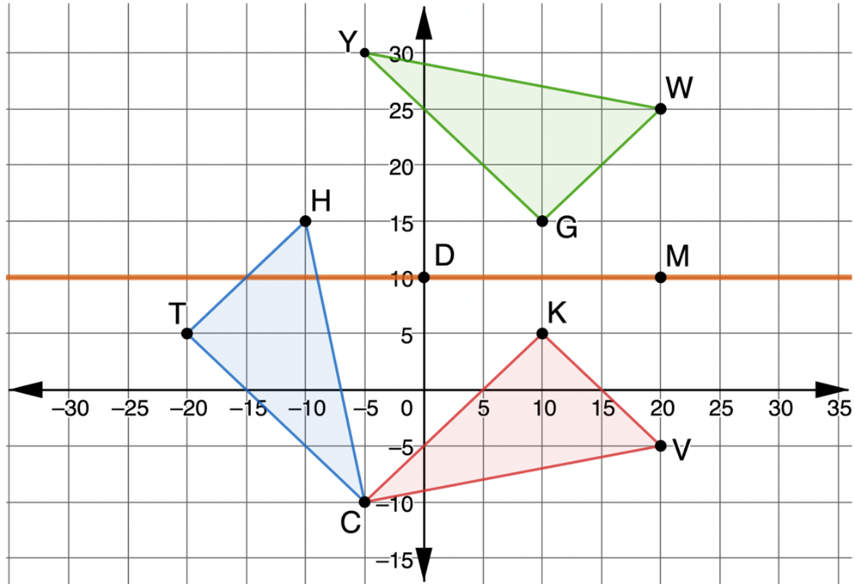
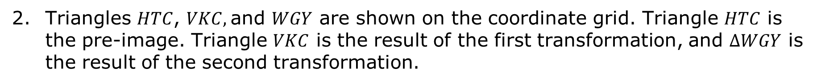
Triangles $HTC$, $VKC,$and $WGY$ are shown on the coordinate grid. Triangle $HTC$ is the pre-image. Triangle $VKC$ is the result of the first transformation, and $∆WGY$ is the result of the second transformation.
volume 1, pg. 192

Slide 12
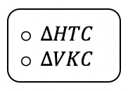
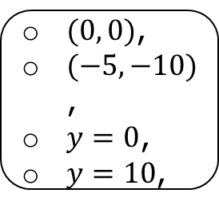
Describe the first transformation.
Use patty paper to show that the transformation preserved distance.
Describe the second transformation.
Use patty paper to show that the second transformation preserved distance.
Work with your partner to complete the statement. Because the
of is
center of rotation
line of reflection
$(0, 0)$,
$(−5, −10)$,
$y=0$,
$y=10$,
can
cannot
an algebraic description
Be used.
volume 1, pg. 192

Slide 13

When Judeline and Carmen completed the statement above, they had different correct answers. Write the second correct answer.
To use an algebraic description of a rotation the center of rotation must be ________.
To use an algebraic description of a reflection the line of reflection must be _________, _________, _________, or _________.
volume 1, pg. 192

Slide 14
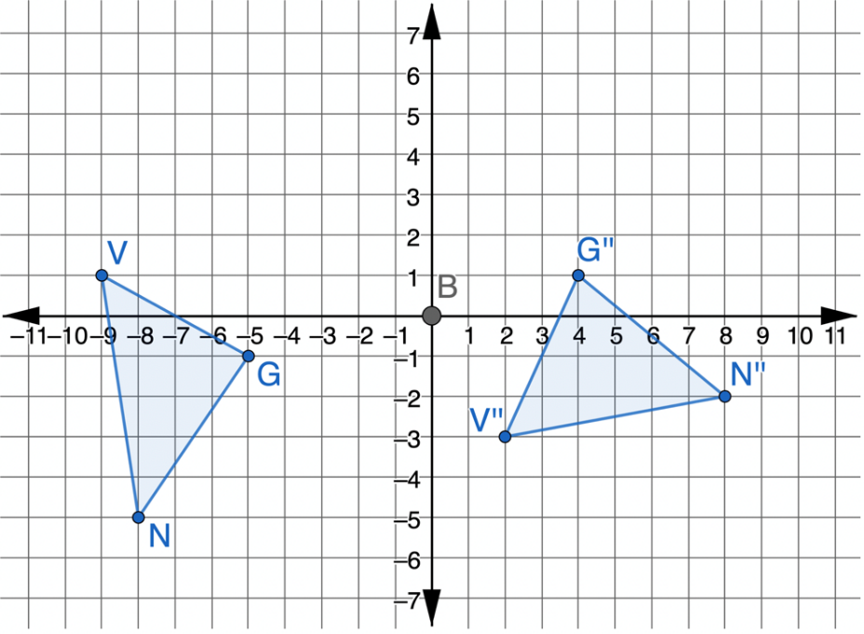
Triangles $NVG$ and $N′′V′′G′′$ are shown on the coordinate grid. Triangle $NVG$ was transformed to create $∆N′′V′′G′′$.
Explain which features of the two triangles can be used to determine that the transformations were rigid motions.
volume 1, pg. 193

Slide 15
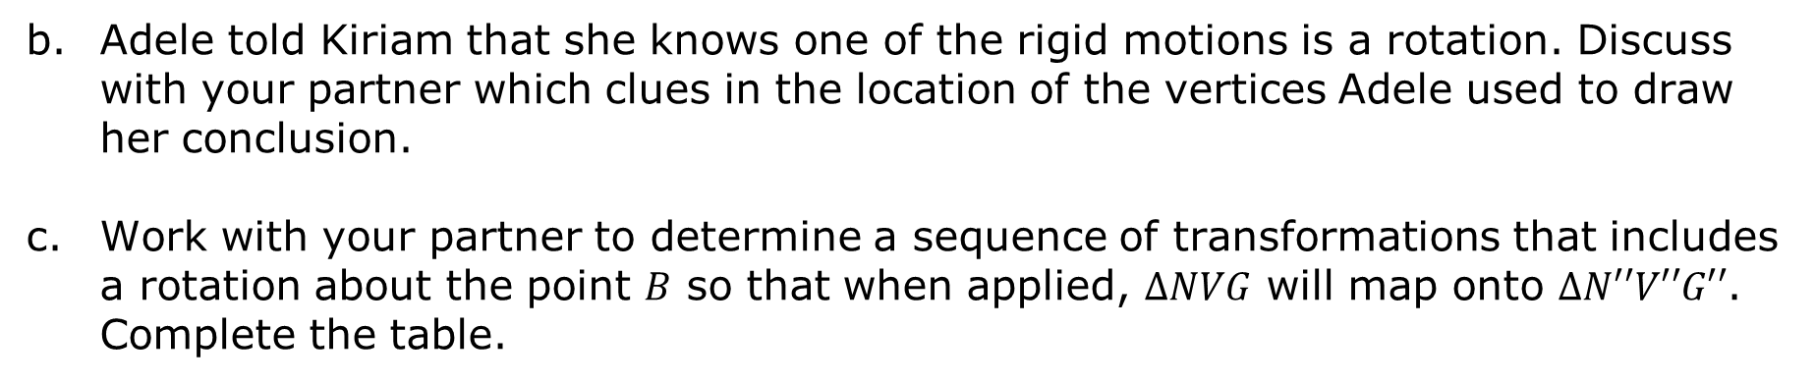
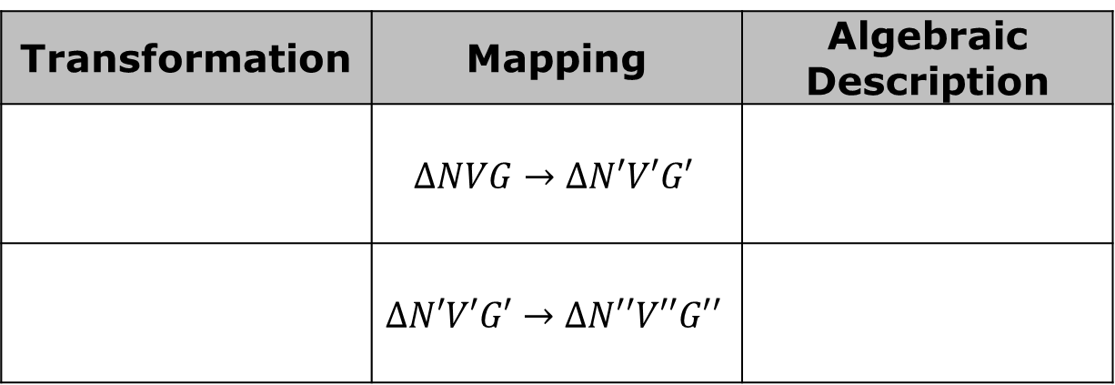
Adele told Kiriam that she knows one of the rigid motions is a rotation. Discuss with your partner which clues in the location of the vertices Adele used to draw her conclusion.
Work with your partner to determine a sequence of transformations that includes a rotation about the point $B$ so that when applied, $∆NVG$ will map onto $∆N′′V′′G′′$. Complete the table.
Transformation | Mapping | Algebraic Description
 | $$∆NVG→∆N′V′G′$$
 | $$∆N′V′G′→∆N′′V′′G′′$$
volume 1, pg. 193

Slide 16

Guided Practice
volume 1, pg. 194

Slide 17

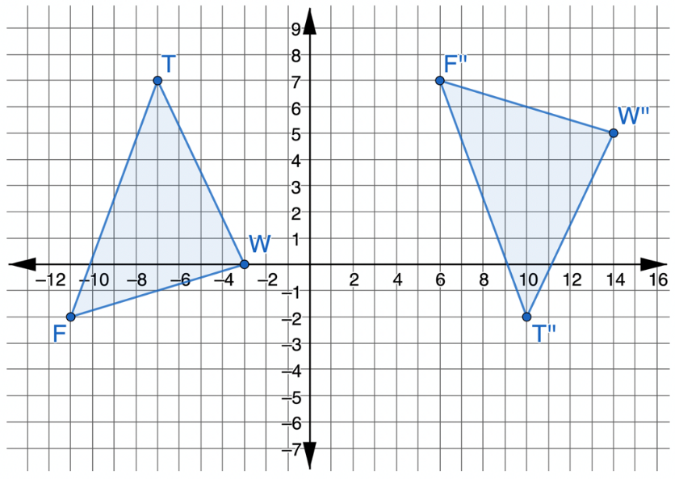
4.3.3 Guided Practice: Sequence of Transformations
Triangles $TWF$ and $T′′W′′F′′$ are shown on the coordinate plane.
volume 1, pg. 194

Slide 18
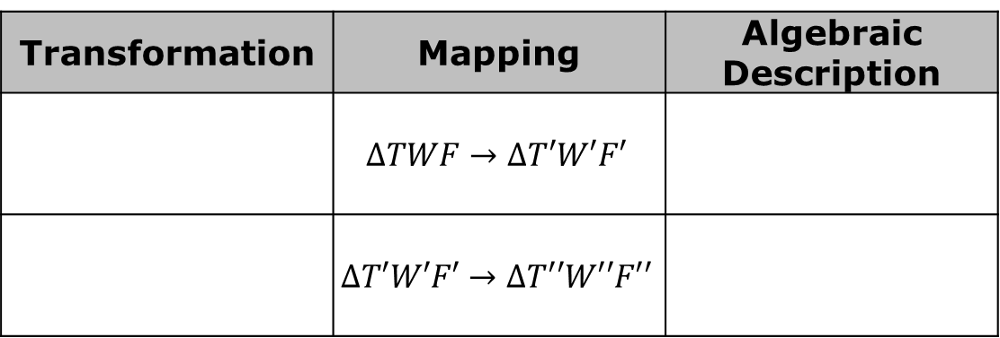
Determine a sequence of transformations that will map $∆TWF$ onto $∆T′′W′′F′′$. Complete the table.
Transformation | Mapping | Algebraic Description
 | $$∆TWF→∆T′W′F′$$
 | $$∆T′W′F′→∆T′′W′′F′′$$
volume 1, pg. 194

Slide 19

Your Turn
volume 1, pg. 194

Slide 20
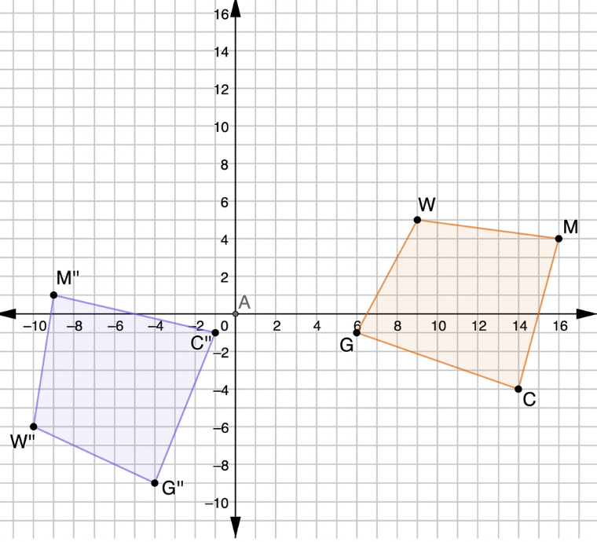
4.3.4 Your Turn!
Quadrilateral $MCGW$ was transformed to create quadrilateral $M′′C′′G′′W′′$.
volume 1, pg. 194

Slide 21
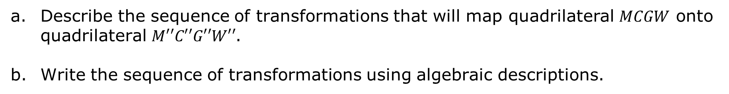
Describe the sequence of transformations that will map quadrilateral $MCGW$ onto quadrilateral $M′′C′′G′′W′′$.
Write the sequence of transformations using algebraic descriptions.
volume 1, pg. 194

Slide 22

Wrap-Up
volume 1, pg. 195

Slide 23
4.3.5 Wrap-Up: Reflection
Check the box that describes your understanding of each learning target.
I can identify transformations that preserve distance and I am ready for the next lesson. I need some help identifying transformations that preserve distance. One area in which I need help is_____________________________________. I can specify a sequence of transformation that will map a given figure onto another congruent figure. I need some help specifying a sequence of transformation that will map a given figure onto another congruent figure. One area in which I need help is ____________________________________. I need more support in knowing how to identify transformations that preserve distance. I am concerned I will not be ready to move on. One area in which I need help is__________________________.
volume 1, pg. 195

